Slide 1
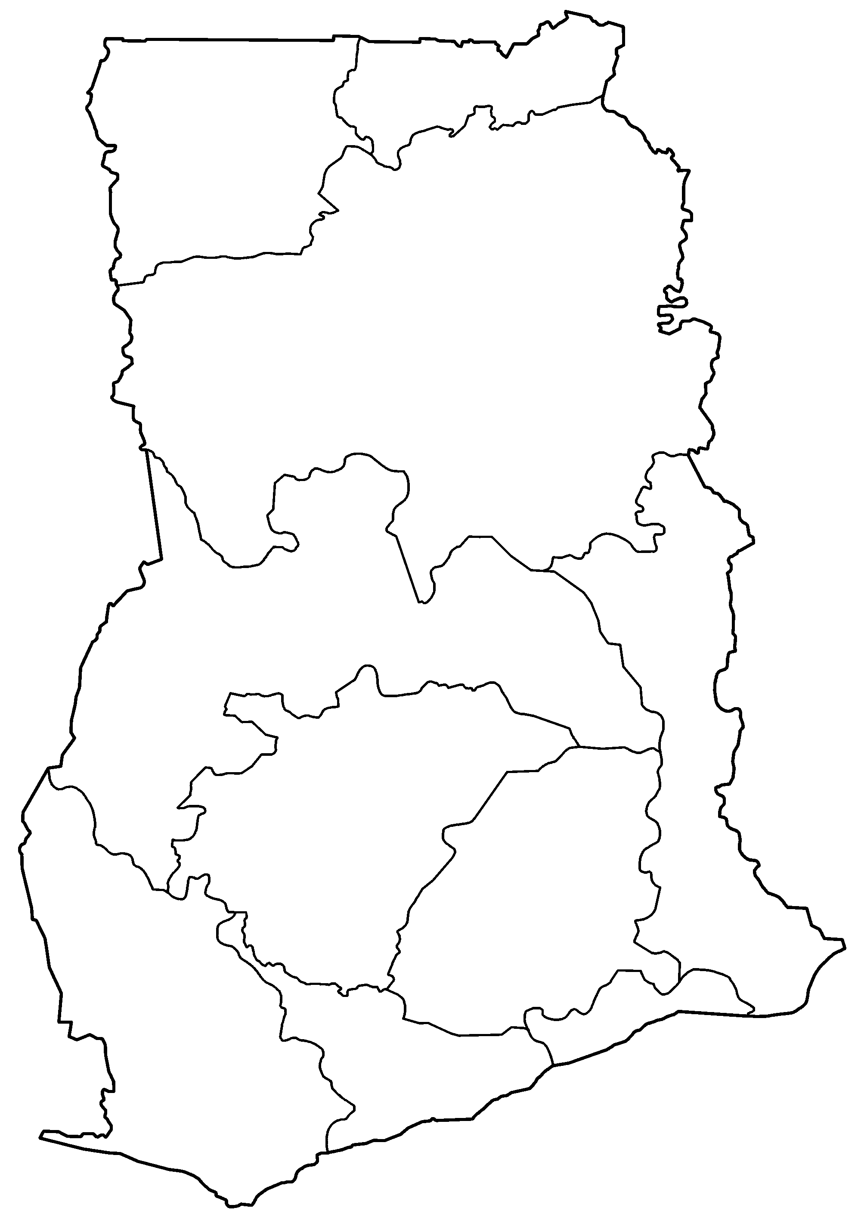
Data Crosswalk
Goal: Interchangeable results data across organizations, locations, and time.
STEP 1: Gathering data
STEP 2: Classification
Results indicators are gathered from multiple sources
Indicators are classified into topical themes
- Live-birth deliveries
- Family planning method used
- Government health clinic
- Skilled physician availability
- Cigarette smoking rate
- Abortion rate
- Condom use
- Tested for HIV
- Tested for Syphilis
- Maternal care
- Health system capacity
- Family planning
- Health facility tracking
- Drug/ alcohol use
- HIV/AIDS
- Disease prevention
Themes are created using most-common keywords and other topics of interest
Ghana:
Northern Region:
Year 2012
STEP 3: Crosswalkable indicators
Interchangeable indicators are identified within each theme
Reduction in malaria (WHO/WB)
STEP 4: Data crosswalk
WHO
Reduction in malaria
WB
Reduction in malaria
Interchangeable indicators can be merged (crosswalked) by location and time period
Data Needs for Crosswalk
Who’s involved
What we need
What we do
What you get
Results-level data
(e.g. M&E results)
We clean, organize, and code this data for anonymity in order to use it for the crosswalk exercise
- Proof of concept of crosswalk potential
- Cleaned, organized data
- Coded project information
- Cross-project comparisons
- Access to crosswalk database
- National governments
- Local governments
- Development agencies
- Implementers
Project/ program information
(e.g. program descriptions)
We code and use this metadata to create themes and project-to-project comparisons

Slide 2
Motivation for crosswalk
Hypothesis: Interchangeable results can increase cooperation and coordination.
Key issues
Data Quality
Data Accessibility
Data Comparability
Data Use
Differences in collection, organization, and cleaning techniques mean that data structures are not comparable and may have inconsistencies.
Indicator definition and storage differences mean that it can be rare for two datasets to cross paths, even within the same organization.
The breadth of aid interventions means that data is often project-specific, thus making it hard to compare to similar results even within the same sector.
Using results data to improve accountability, reporting, and decision-making is essential, but can be impeded due to these issues and more.
Addressing issues through the Crosswalk
Cleaning the slate
Bringing it all together
Finding harmony
Focusing on users
By systematically organizing and cleaning data, we can improve basic usability as well as facilitate future data aggregation and compatibility.
By bringing together project background information as well as metadata, each results dataset can be classified and placed alongside sets with similar themes and indicators.
Once organized into a logical structure, indicators can be directly compared, aggregated, and analyzed across organizations, locations, and years.
We seek to involve individuals, organizations, and governments so that our data work is applicable to diverse settings, reporting structures, and on-the-ground needs.

